Slide 1
SPINAL VISION CNN-DRIVEN TECHNIQUES FOR ACCURATE STENOSIS DETECTION

Slide 2
ABSTRACT:
Spinal lumbar stenosis is a prevalent degenerative condition affecting the spinal canal, leading to compression of neural structures and subsequent symptoms such as pain and reduced mobility. Accurate and timely classification of lumbar stenosis stages is crucial for effective treatment planning and patient management. This study proposes a novel approach employing Convolutional Neural Network (CNN) techniques for the automated detection and classification of spinal lumbar stenosis stages. The proposed CNN-based framework utilizes advanced image processing and deep learning methodologies to analyse medical imaging data, such as magnetic resonance imaging (MRI) and computed tomography (CT) scans. The convolutional layers of the network are designed to automatically extract hierarchical features from the input images, capturing intricate patterns associated with different stages of lumbar stenosis. The model is trained on a diverse dataset encompassing various degrees of stenosis severity, ensuring robust generalization to unseen cases. The research focuses on achieving high accuracy, sensitivity, and specificity in classifying lumbar stenosis stages, thereby assisting healthcare professionals in making informed decisions about patient care. The results obtained from the proposed CNN-based classification system are compared with existing methods to validate its efficacy and superiority in terms of diagnostic performance. This study not only contributes to the field of medical image analysis but also addresses the pressing need for accurate and efficient tools for lumbar stenosis stage classification. The integration of deep learning techniques in this context holds promising potential for enhancing diagnostic capabilities and streamlining treatment strategies, ultimately improving patient outcomes in the management of spinal lumbar stenosis.

Slide 3
EXISTING SYSTEM:
Locomotion disorder caused by spinal cord injury (SCI) leads to a considerably decreased quality of people’s lives. Although there are no known cure methods for SCI, a lower extremity exoskeleton (LEE) has a perspective to restore the locomotion ability of SCI patients. Statistics show that the number of published articles on LEEs has exponentially increased over the past 20 years; however, no reviews have been conducted to summarize these studies comprehensively. To fill up this open gap, a comprehensive review from engineering to clinical standpoint is carried out, which is based on the preferred reporting items for systematic reviews and meta-analyses’ methods, including their structural designs, drive forms, control methods, and clinical assessments. A systematic discussion among them is performed while considering the main scientific and technical aspects. The analysis indicates that the actuator configuration, motor selection, state transition, trajectory tracking, transparency implementation, and clinical factor design in exoskeleton development are full of challenges, which should be investigated in more technical efforts in the future.

Slide 4
Drawbacks:
They did not implement the deployment process
They implemented simple method. They did not Implement Convolution neural network and artificial neural network.
They did not do image preprocessing process.
They did not do data analysis process by using Plot and Graphs.
They did not compared more than an architecture to getting better accuracy level.
They are only found spinal Spinal Cord Injury
They did not train the training data to computer properly.

Slide 5
INTRODUCTION
The detection and classification of spinal lumbar stenosis stages represent a critical area in medical imaging, where accurate diagnosis plays a pivotal role in effective patient care. This study employs Convolutional Neural Network (CNN) techniques, a subset of deep learning, to enhance the precision and efficiency of spinal lumbar stenosis identification. By leveraging the advanced pattern recognition capabilities of CNNs, the proposed methodology aims to automate the classification of different stenosis stages based on medical imaging data. This innovative approach not only streamlines the diagnostic process but also holds the potential to improve overall patient outcomes by facilitating timely and accurate treatment interventions tailored to specific stenosis severity levels.

Slide 6
PROPOSED SYSTEM:
The proposed system for the detection and classification of spinal lumbar stenosis stages utilizes advanced Convolutional Neural Network (CNN) techniques to enhance diagnostic accuracy and streamline patient care. Leveraging the power of deep learning, this innovative approach aims to categorize different stages of lumbar stenosis with a high degree of precision, providing healthcare professionals with valuable insights for tailored treatment plans. The CNN architecture employed in this system is designed to analyze medical imaging data, such as MRIs and CT scans, allowing for automated and efficient identification of lumbar stenosis severity. By harnessing the capabilities of neural networks, the proposed system contributes to a more nuanced understanding of spinal health, facilitating early intervention and personalized medical interventions. This technology represents a significant stride toward improving diagnostic capabilities in the field of orthopedics, ultimately enhancing patient outcomes and quality of care.

Slide 7
Advantages:
We implemented the deployment process by using Frontend codes like Html, Css, Bootstrap and Python Framework like Django or Flask.
We implemented image preprocessing process by using Rescale, Horizontal flip, Shear range and Zoom range.
We implemented data analysis process by using Plot and Graphs.
We compared more than a two architecture to getting better accuracy level.
We classify into 4 Spine stenosis disease. The proposed system leverages deep learning (CNN architectures) to automatically extract and analyse patterns in spine stenosis images.
We figure out performance metrics value properly.
We improved the accuracy level and performance level.
We implemented Convolution neural network and artificial neural network concept properly.
We did train the training data to computer properly. We implemented the test data to testing the output values.

Slide 8
PREPARING THE DATASET:
This dataset contains train and test image records of features extracted, which were then classified into 4 classes:

Slide 9
Review of Literature Survey
Title : Artificial intelligence and machine learning in spine research
Author : Fabio Galbusera | Gloria Casaroli | Tito Bassani
Year : 2018
Artificial intelligence (AI) and machine learning (ML) techniques are revolutionizing several industrial and research fields like computer vision, autonomous driving, natural language processing, and speech recognition. These novel tools are already having a major impact in radiology, diagnostics, and many other fields in which the availability of automated solution may benefit the accuracy and repeatability of the execution of critical tasks. In this narrative review, we first present a brief description of the various techniques that are being developed nowadays, with special focus on those used in spine research. Then, we describe the applications of AI and ML to problems related to the spine which have been published so far, including the localization of vertebrae and discs in radiological images, image segmentation, computer-aided diagnosis, prediction of clinical outcomes and complications, decision support systems, content-based image retrieval, biomechanics, and motion analysis. Finally, we briefly discuss major ethical issues related to the use of AI in healthcare, namely, accountability, risk of biased decisions as well as data privacy and security, which are nowadays being debated in the scientific community and by regulatory agencies.

Slide 10
Title : Clinical, Kinematic and Muscle Assessment of Bilateral Coordinated Upper-Limb Movements Following Cervical Spinal Cord Injury
Author : Amy Bellitto , Alice De Luca, Simona Gamba, Luca Losio, Antonino Massone, Maura Casadio , and Camilla Pierella
Year : 2023
— Cervical spinal cord injury (cSCI) often results in bilateral impairment of the arms, leading to difficulties in performing daily activities. However, little is known about the neuromotor alterations that affect the ability of individuals with cSCI to perform coordinated movements with both arms. To address this issue, we developed and tested a functional assessment that integrates clinical, kinematic, and muscle activity measures, including the evaluation of bilateral arm movements. Twelve subjects with a C5-C7 spinal lesion and six unimpaired subjects underwent an evaluation that included three tests: the Manual Muscle Test, Range Of Motion test and Arm stabilisation test, a subsection of the “Van Lieshout arm/hand function test”. During the latter, we recorded kinematic and muscle activity data from the upper-body during the execution of a set of movements that required participants to stabilize both arms against gravity at different config urations. Analytical methods, including muscle synergies, spinal maps, and Principal Component Analysis, were used to analyse the data. Clinical tests detected limitations in shoulder abduction-flexion of cSCI participants and alterations in elbows-wrists motor function. The instrumented assessment provided insight into how these limitations impacted the ability of cSCI participants to perform bilateral movements. They exhibited severe difficulty in performing movements involving over-the-shoulder motion and shoulder internal rotation due to altered patterns of activity of the scapular stabilizer muscles, latissimus dorsi, pectoralis, and triceps. Our findings shed light on the bilateral neuromotor changes that occur post-cSCI addressing not only motor deficits, but also the underlying abnormal, weak, or silent muscle activations.

Slide 11
Title : Data-driven diagnosis of spinal abnormalities using feature selection and machine learning algorithms
Author : Md. Raihan-Al-MasudID, M. Rubaiyat Hossain MondalID
Year : 2020
This paper focuses on the application of machine learning algorithms for predicting spinal abnormalities. As a data preprocessing step, univariate feature selection as a filter based feature selection, and principal component analysis (PCA) as a feature extraction algorithm are considered. A number of machine learning approaches namely support vector machine (SVM), logistic regression (LR), bagging ensemble methods are considered for the diagnosis of spinal abnormality. The SVM, LR, bagging SVM and bagging LR models are applied on a dataset of 310 samples publicly available in Kaggle repository. The performance of classification of abnormal and normal spinal patients is evaluated in terms of a number of factors including training and testing accuracy, recall, and miss rate. The classifier models are also evaluated by optimizing the kernel parameters, and by using the results of receiver operating characteristic (ROC) and precision-recall curves. Results indicate that when 78% data are used for training, the observed training accuracies for SVM, LR, bagging SVM and bagging LR are 86.30%, 85.47%, 86.72% and 85.06%, respectively. On the other hand, the accuracies for the test dataset for SVM, LR, bagging SVM and bagging LR are the same being 86.96%. However, bagging SVM is the most attractive as it has a higher recall value and a lower miss rate compared to others. Hence, bagging SVM is suitable for the classification of spinal patients when applied on the most five important features of spinal samples.

Slide 12
Title : DXplorer: A Unified Visualization Framework for Interactive Dendritic Spine Analysis Using 3D Morphological Features
Author : JunYoung Choi , Sang-Eun Lee , YeIn Lee, Eunji Cho , Sunghoe Chang , and Won-Ki Jeong
Year : 2023
—Dendritic spines are dynamic, submicron-scale protrusions on neuronal dendrites that receive neuronal inputs. Morphological changes in the dendritic spine often reflect alterations in physiological conditions and are indicators of various neuropsychiatric conditions. However, owing to the highly dynamic and heterogeneous nature of spines, accurate measurement and objective analysis of spine morphology are major challenges in neuroscience research. Most conventional approaches for analyzing dendritic spines are based on two-dimensional (2D) images, which barely reflect the actual three-dimensional (3D) shapes. Although some recent studies have attempted to analyze spines with various 3D-based features, it is still difficult to objectively categorize and analyze spines based on 3D morphology. Here, we propose a unified visualization framework for an interactive 3D dendritic spine analysis system, DXplorer, that displays 3D rendering of spines and plots the high-dimensional features extracted from the 3D mesh of spines. With this system, users can perform the clustering of spines interactively and explore and analyze dendritic spines based on high-dimensional features. We propose a series of high-dimensional morphological features extracted from a 3D mesh of dendritic spines. In addition, an interactive machine learning classifier with visual exploration and user feedback using an interactive 3D mesh grid view ensures a more precise classification based on the spine phenotype. A user study and two case studies were conducted to quantitatively verify the performance and usability of the DXplorer. We demonstrate that the system performs the entire analytic process effectively and provides high-quality, accurate, and objective analysis.

Slide 13
SYSTEM STUDY
Aim:
This study aims to implement Convolutional Neural Network (CNN) architectures for accurate and automated classification of spine stenosis in medical imaging.
Objectives:
The objective of detecting and classifying stages of spinal lumbar stenosis using Convolutional Neural Network (CNN) techniques is to enhance the accuracy and efficiency of diagnosis in this medical condition. Spinal lumbar stenosis is a prevalent disorder characterized by the narrowing of the spinal canal, often leading to debilitating symptoms. The application of CNNs in medical image analysis enables automated and precise recognition of specific patterns and features indicative of different stages of lumbar stenosis. This approach aims to provide clinicians with a reliable tool for early detection, classification, and personalized treatment planning, ultimately improving patient outcomes by facilitating timely interventions and reducing the risk of complications associated with this spinal disorder.

Slide 14
Scope:
The detection of spinal lumbar stenosis stages through Convolutional Neural Network (CNN) techniques holds promising prospects in the field of medical image analysis. By leveraging advanced deep learning methodologies, this approach allows for automated and accurate classification of different stages of spinal lumbar stenosis, providing a more efficient and objective diagnostic tool. CNNs excel in extracting intricate features from medical images, enabling the model to discern subtle variations in spinal structures indicative of different stenosis stages. This technology not only enhances the speed and precision of diagnosis but also has the potential to assist healthcare professionals in tailoring appropriate treatment plans for patients based on the severity of their condition. As a result, the application of CNN techniques in the detection and classification of spinal lumbar stenosis stages represents a significant stride towards improving patient care and diagnostic efficiency in the realm of spinal disorders.

Slide 15
Environment Requirements:
1. Software Requirements:
Operating System : Windows / Linux
Simulation Tool : Anaconda with Jupyter Notebook
2. Hardware requirements:
Processor : Pentium IV/III
Hard disk : minimum 80 GB
RAM : minimum 2 GB

Slide 16
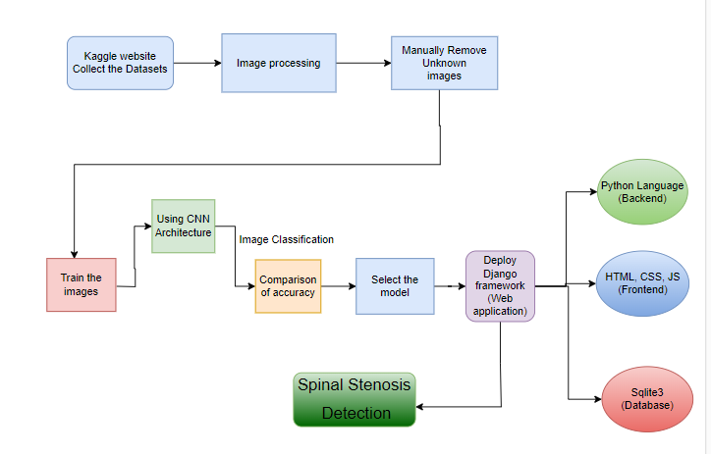
System Architecture:

Slide 17
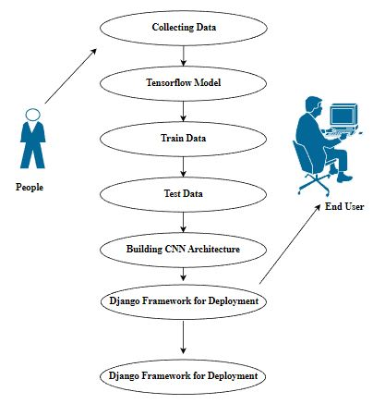
USECASE DIAGRAM:

Slide 18
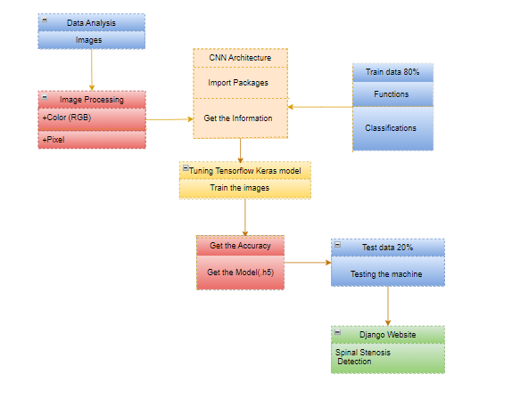
CLASS DIAGRAM:

Slide 19
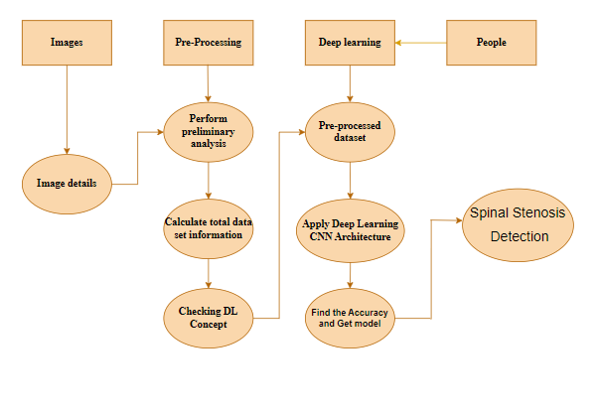
ACTIVITY DIAGRAM:

Slide 20
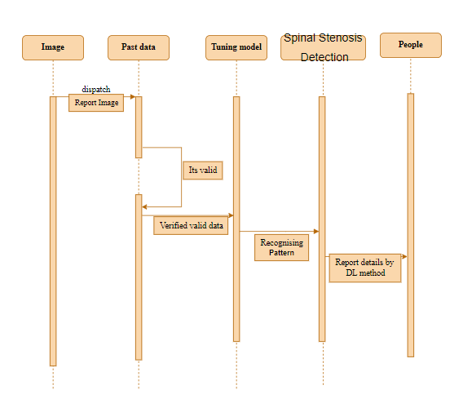
SEQUENCE DIAGRAM:

Slide 21
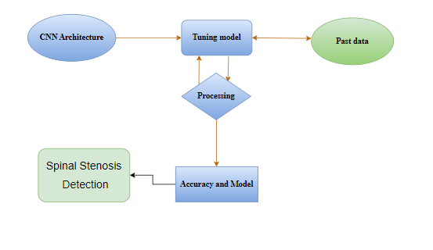
ER DIAGRAM:

Slide 22
List of modules
MANUAL NET
GOOGLE NET
LEENET
DEPLOYMENT

Slide 23
GOOGLE NET:
"GoogleNet," also known as "Inception-v1," is a deep learning architecture for image classification. It was developed by a team of researchers at Google, led by Christian Szegedy, and was the winner of the ImageNet Large Scale Visual Recognition Challenge (ILSVRC) in 2014.
The main innovation in the GoogleNet architecture is the use of the "Inception module," which incorporates multiple parallel convolutional operations of different filter sizes to capture features at various scales. This allows the network to learn both fine-grained and high-level abstract features efficiently.
Key features of the GoogleNet architecture:
Inception Module: The Inception module consists of a combination of 1x1, 3x3, and 5x5 convolutional filters, along with max-pooling operations. The idea behind this module is to allow the network to learn features at different spatial scales and capture both local and global patterns effectively. Additionally, 1x1 convolutions are used to reduce the dimensionality of the input channels, which helps in reducing computational complexity.
Multiple Stacked Inception Modules: GoogleNet consists of multiple stacked Inception modules to create a deep network. These modules are designed to capture increasingly complex patterns as the network goes deeper. The inclusion of multiple Inception modules also allows the network to be computationally efficient, as it can utilize different filter sizes simultaneously.
Auxiliary Classifiers: GoogleNet includes auxiliary classifiers at intermediate layers of the network. These auxiliary classifiers serve as "side branches" and are used to combat the vanishing gradient problem during training. They add extra supervision to the network and help in better gradient flow during backpropagation

Slide 24
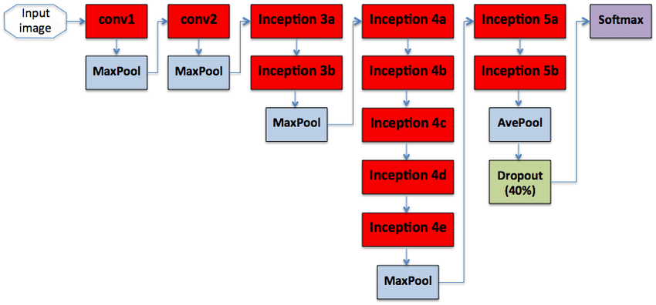
GOOGLE NET:

Slide 25
LENET:
The LeNet architecture is a pioneering convolutional neural network (CNN) architecture developed by Yann LeCun and his colleagues in the early 1990s. It played a crucial role in the advancement of deep learning and was specifically designed for handwritten digit recognition tasks, such as recognizing digits in checks and postal addresses. LeNet laid the foundation for modern CNNs and their applications in image recognition and computer vision tasks.
The LeNet architecture consists of the following layers:
Input Layer: This layer accepts the input image, which is typically a grayscale image of a handwritten digit. The input images are usually of size 32x32 pixels.
Convolutional Layers: LeNet uses two convolutional layers to extract features from the input images. Each convolutional layer applies convolutional filters (also called kernels) to the input image, capturing different patterns and features. These filters slide over the image to create feature maps.
Subsampling (Pooling) Layers: After each convolutional layer, a subsampling layer (also known as a pooling layer) is applied to reduce the spatial dimensions of the feature maps and help in retaining important information while reducing computation.
Fully Connected Layers: The subsampled feature maps are then flattened and passed through fully connected layers, which are traditional neural network layers. These layers are responsible for making classification decisions based on the extracted features.
Output Layer: The final fully connected layer produces the output of the network, which represents the predicted class probabilities. For handwritten digit recognition, this would typically involve 10 output nodes, each corresponding to a digit class (0 to 9).
LeNet was designed before the deep learning era as we know it today, so it has fewer layers compared to modern architectures like ResNet, VGG, or Inception. However, its fundamental design principles, including the use of convolutional and pooling layers, inspired the development of more complex CNN architectures. LeNet demonstrated the potential of neural networks in handling image recognition tasks and played a pivotal role in the resurgence of interest in neural networks during the early 2000s.

Slide 26
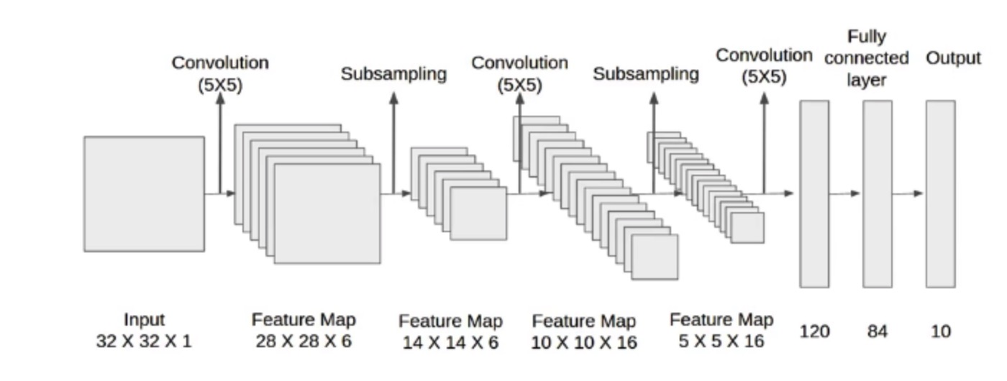

Slide 27

SCREEN SHOTS: LANDING PAGE

Slide 28
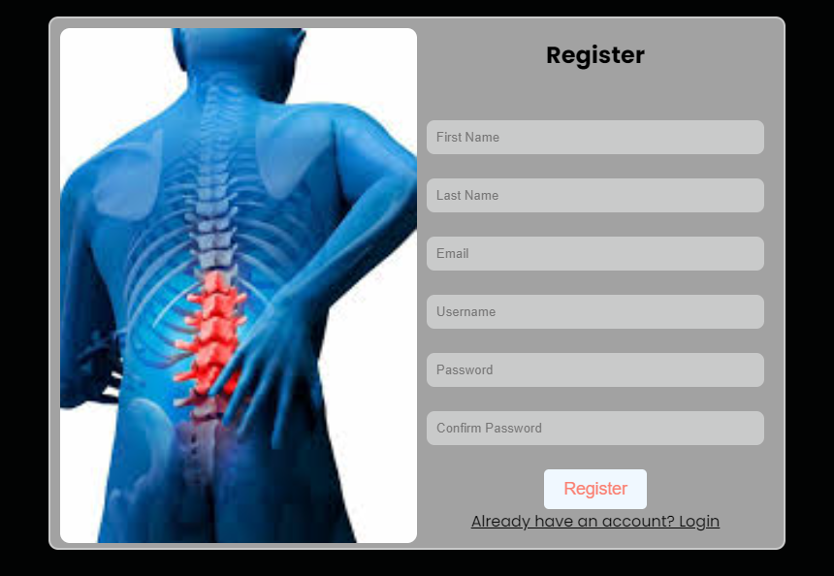
Register Page

Slide 29
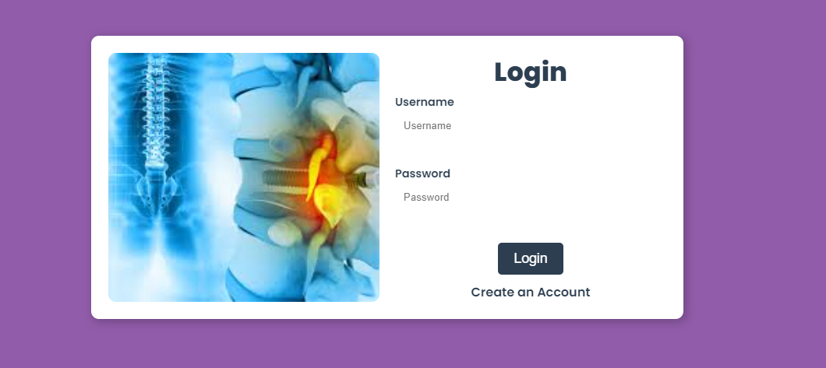
Login Page

Slide 30
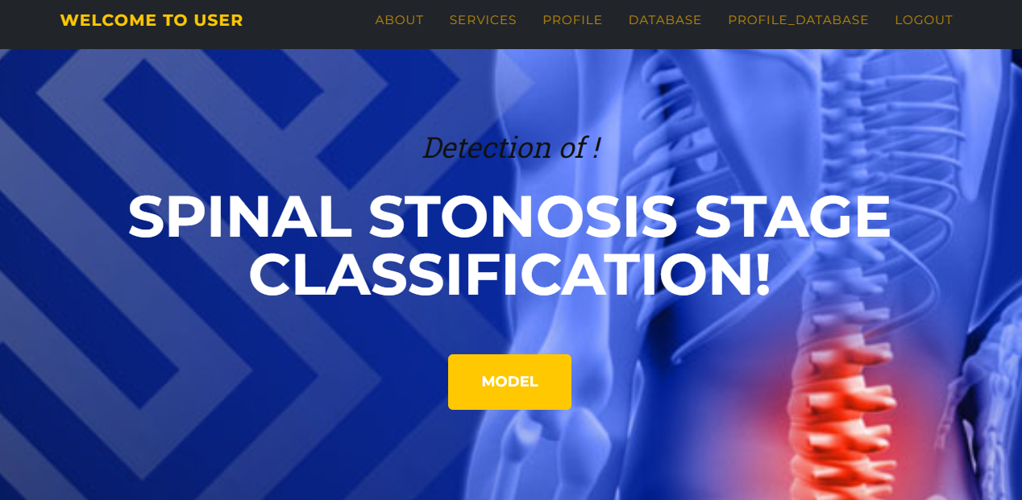
HOME PAGE:

Slide 31
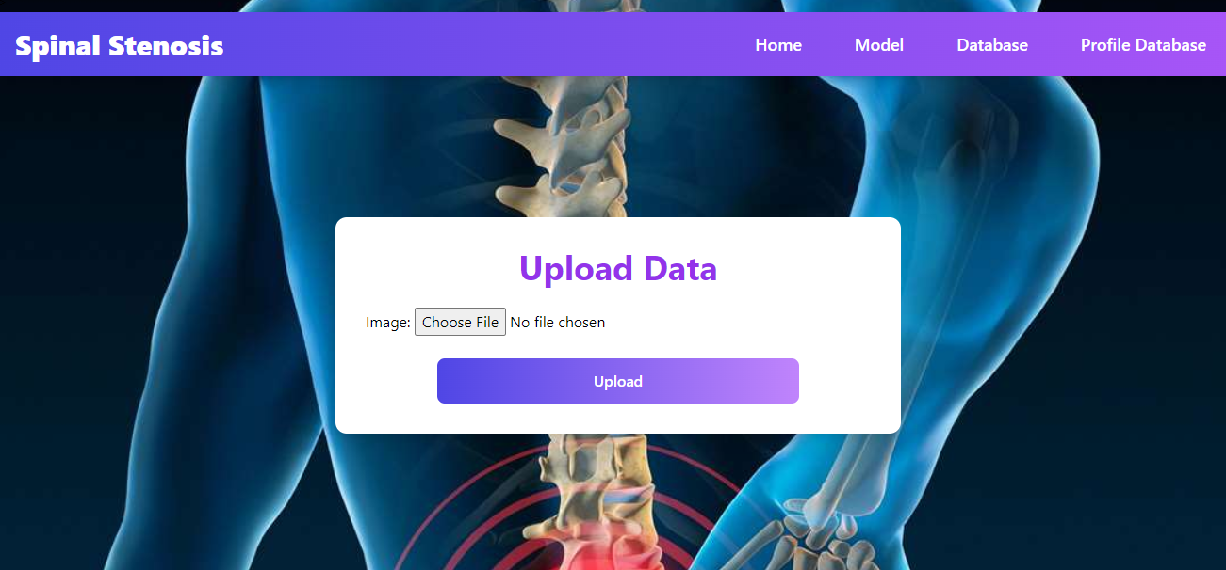
INPUT PAGE

Slide 32
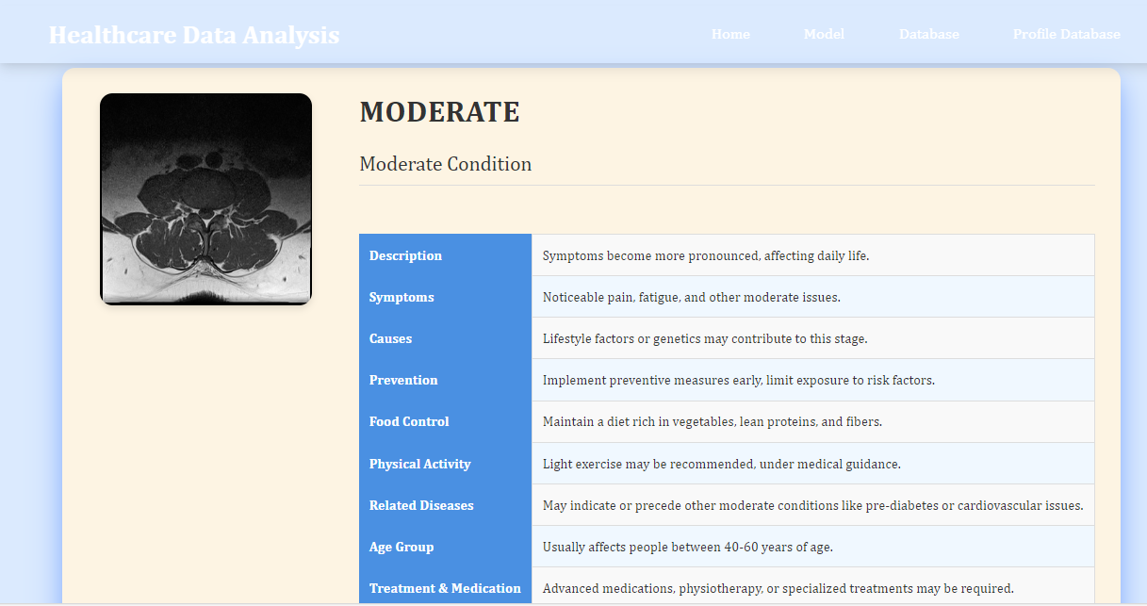
OUTPUT PAGE

Slide 33
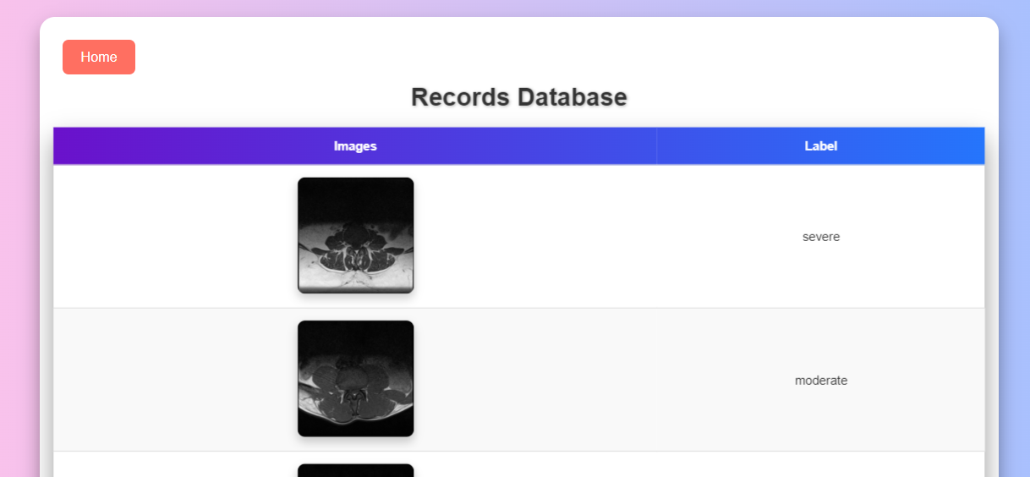
DATABASE PAGE

Slide 34
Conclusion:
In conclusion, the application of Convolutional Neural Network (CNN) architectures in SPINE STENOSIS classification has demonstrated significant strides towards improving diagnostic accuracy in musculoskeletal radiology. The robust feature extraction capabilities of CNNs have enabled the identification and categorization of diverse spine abnormalities with remarkable precision. This technological advancement holds promise for streamlining and enhancing the efficiency of diagnostic processes, ultimately contributing to more inform clinical decision-making. As the field continues to embrace automated image analysis, the integration of CNN architectures stands out as a pivotal step towards revolutionizing spine diagnostics and improving patient outcomes. Further research and refinement of these models promise continued advancements in the realm of automated musculoskeletal imaging analysis.

Slide 35
Future Work:
Medical department wants to automate the detecting of Spine abnormality from eligibility process (real time).
To optimize the work to implement in cloud environment.

